Slide 1
INTERNSHIP REPORT
Mohammed aftabuddin
1604-20-737-058

Slide 2
Overview
Introduction
Copy of Internship Certificate
Overview of the company
Overview of Activities carried out during internship
Work/tasks carried during the internship.
Lessons Learned
Conclusion

Slide 3
INTRODUCTION
Name : Mohammed Aftabuddin
Roll No. : [1604-20-737-058]
Internship Organization : Inventrom pvt ltd – Bolt IoT
Website: https://www.boltiot.com/
Position: Web App Developer Intern
Internship Period: 2 months

Slide 4
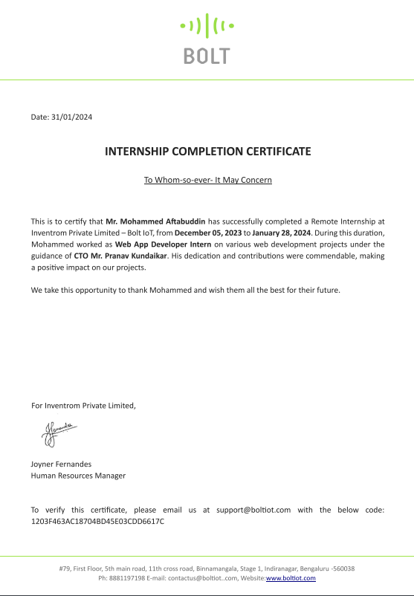
Internship Certificate
Offer Letter : Link
Internship Certificate : Link

Slide 5
Inventrom Private Limited – Bolt IoT
Overview: Bolt IoT is a pioneering company at the forefront of the Internet of Things (IoT) solutions.
Mission: Bolt IoT is committed to empowering individuals and organizations to harness the power of IoT for innovative and transformative solutions.
Core Services:
IoT Platform: Providing a robust and user-friendly platform for seamless IoT device integration and data management.
Web Development: Crafting cutting-edge web solutions to meet the evolving needs of the digital landscape.

Slide 6
Overview of Activities carried out during internship
Role: Web App Developer Intern
Activities :
Developing and maintaining web applications and webpages
Designing user interfaces and ensuring responsive design
Integrating with APIs and third-party tools
Writing clean and maintainable code
Collaborating with designers and other developers

Slide 7
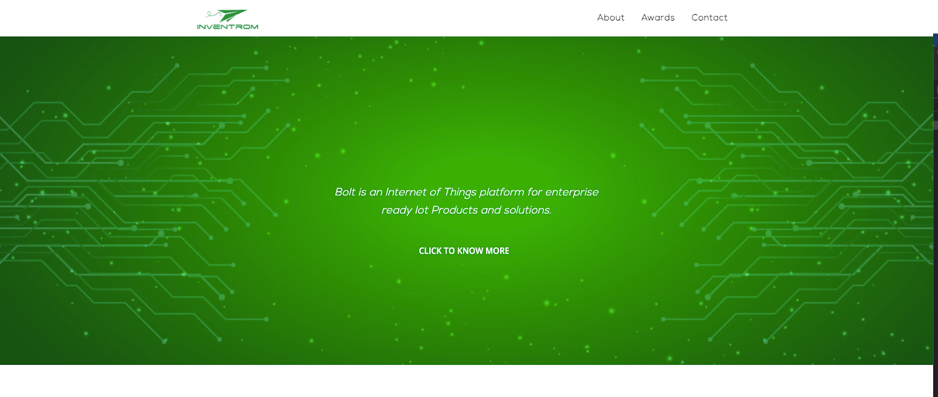
Work/Tasks Carried Out During Internship
Project Showcase 1: Company Website Homepage
Objective: Redesign homepage for improved user experience
Improvements: Clearer navigation, engaging call to action, mobile-friendly design

Slide 8
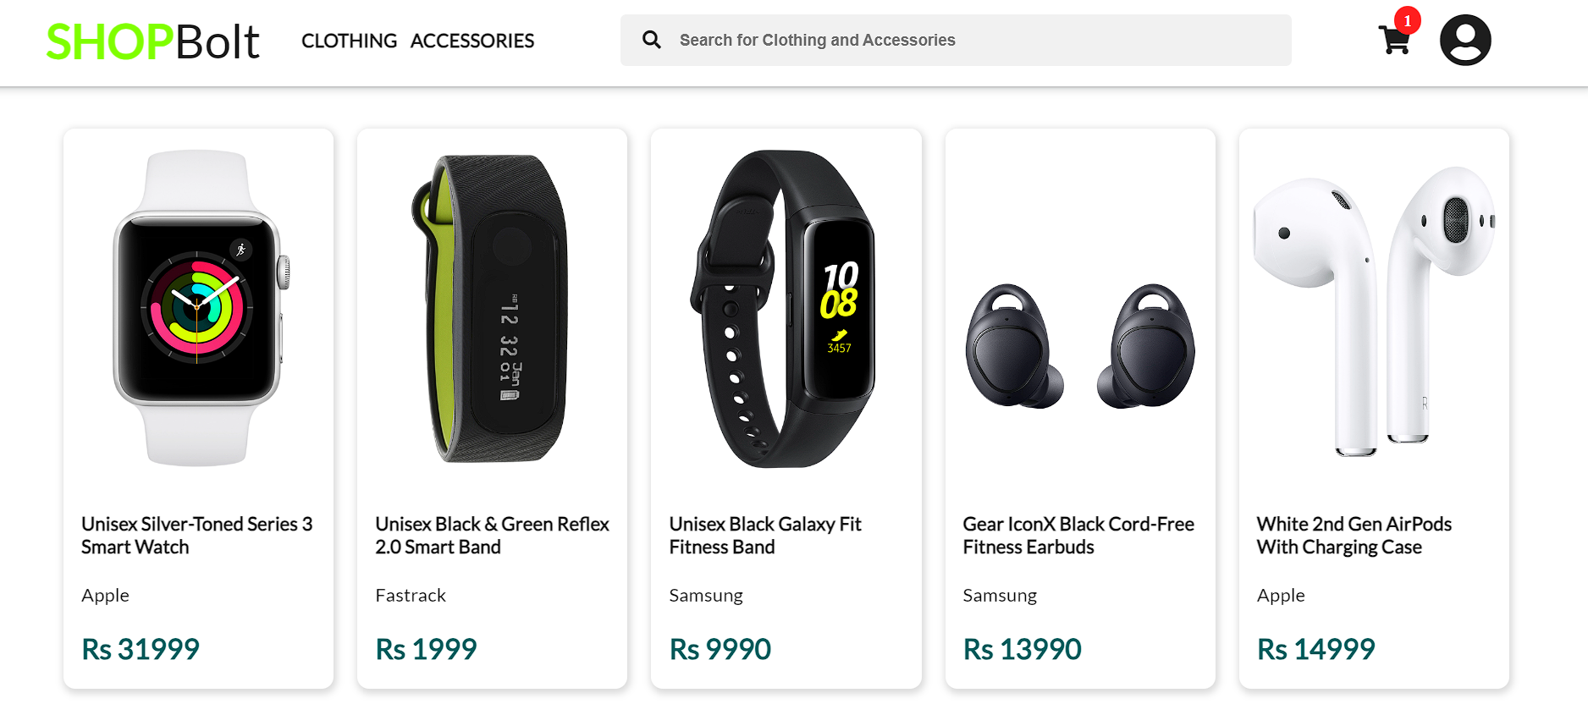
Work/Tasks Carried Out During Internship
Project Showcase 2: Ecommerce webpage
Objective: Designed an intuitive user interface for an ecommerce webpage.
Features: Clear and concise product categorization.

Slide 9
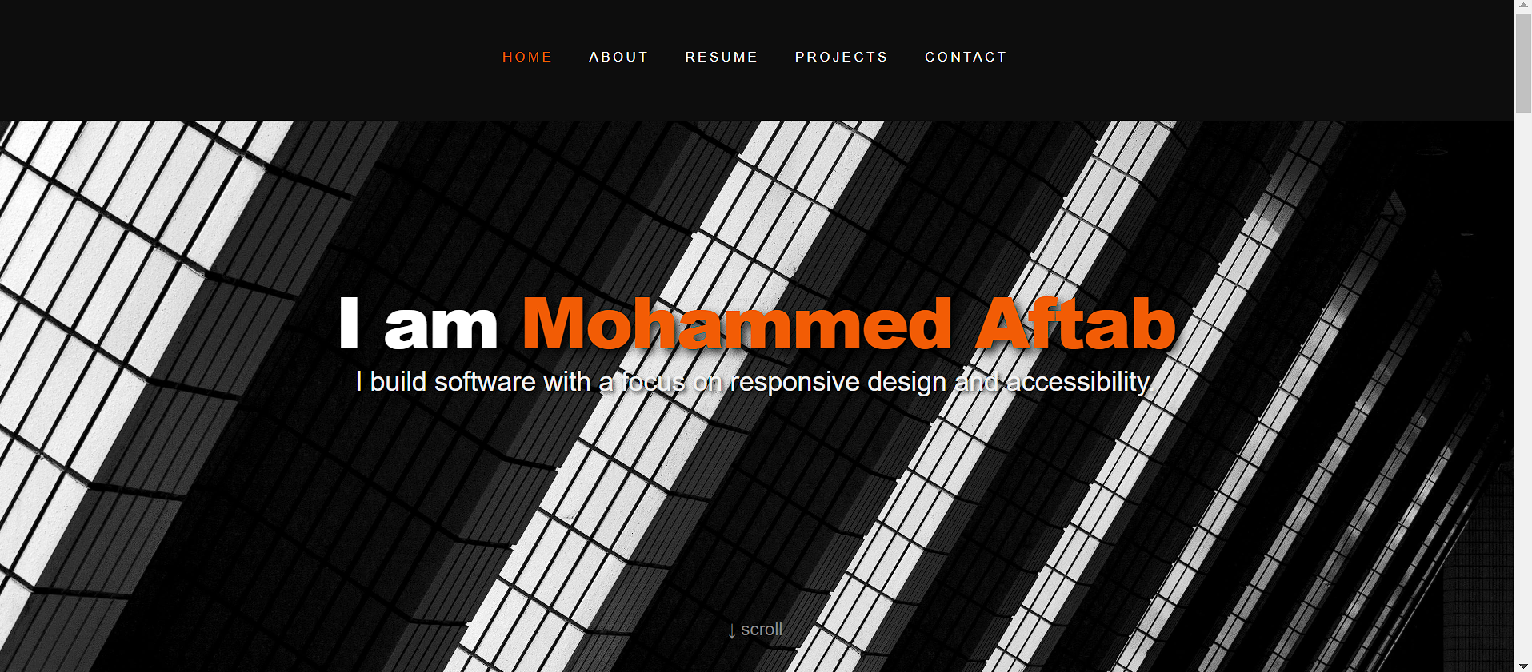
Work/Tasks Carried Out During Internship
Project Showcase 3: Portfolio Website Template
Objective: Create customizable portfolio template for diverse needs
Features: Multiple layout options, easy customization through CSS classes

Slide 10
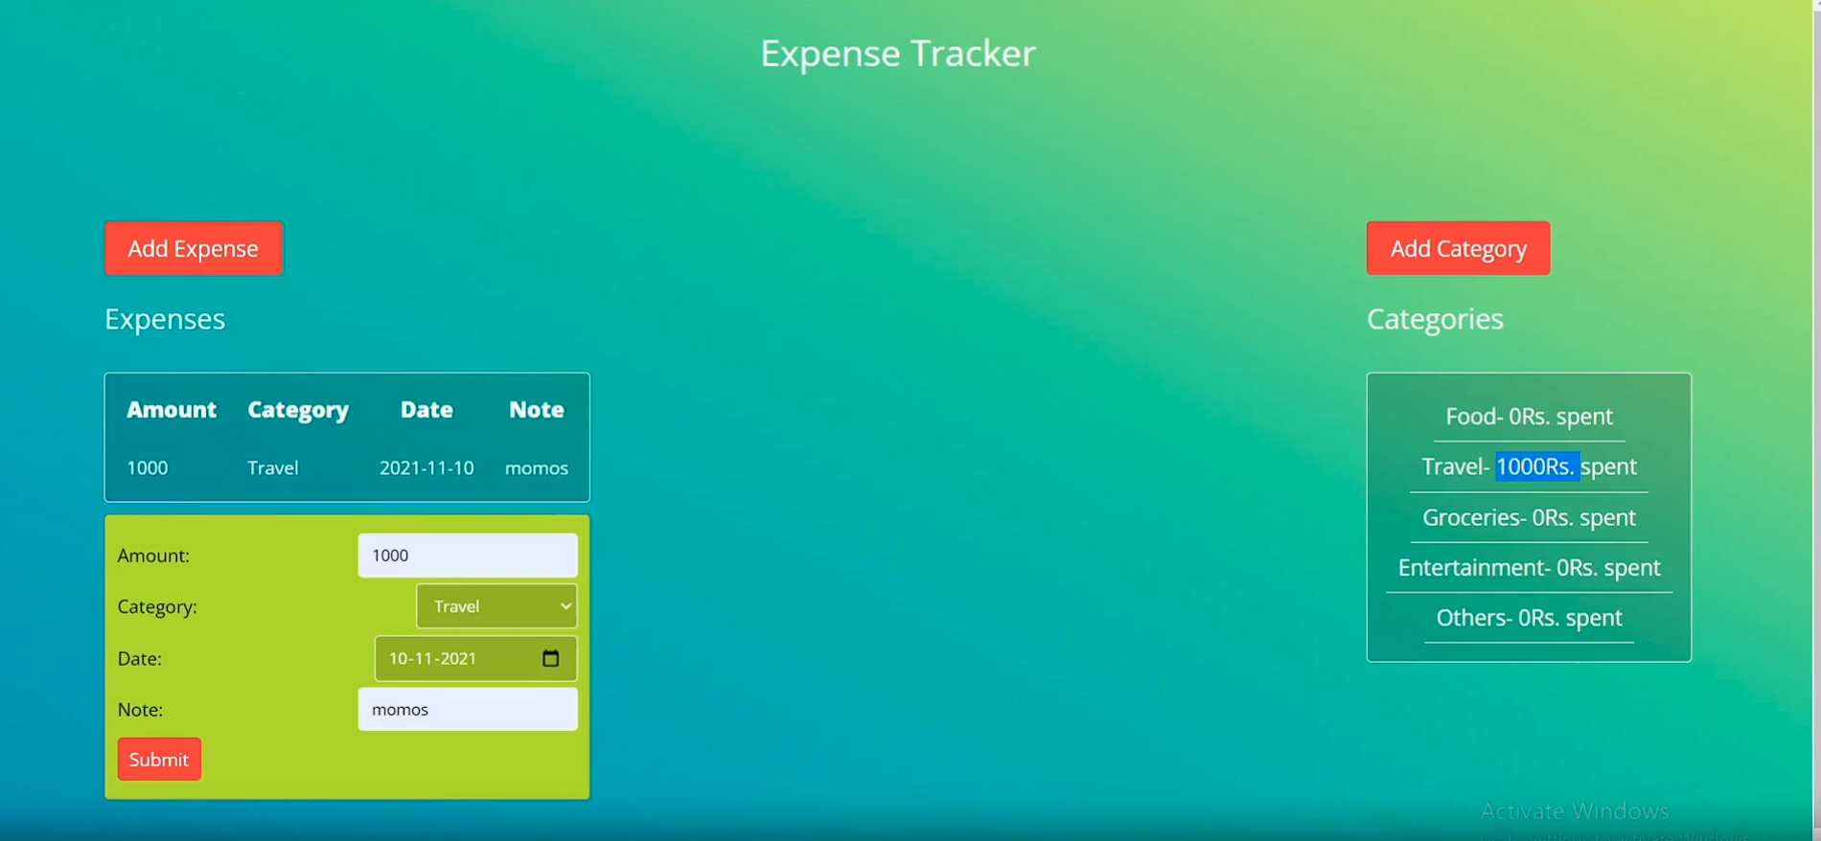
Work/Tasks Carried Out During Internship
Project Showcase 4: Expense Tracker
Objective: To develop expense tracker web application
Features: User friendly web interface.

Slide 11
Learning Outcomes
Skills and Technologies Gained:
Html/CSS
Javascript
React
Bootstrap
Api embedding
Material Design
Problem solving
Team work & communication

Slide 12
Conclusion
It was a very valuable experience showing me the workflow in web development and how to work in a small team and will probably help me in my career a lot. Looking ahead, I'm enthusiastic about applying these skills in future projects. Thank you for the opportunity.

Slide 13
Thank You

